Slide 1

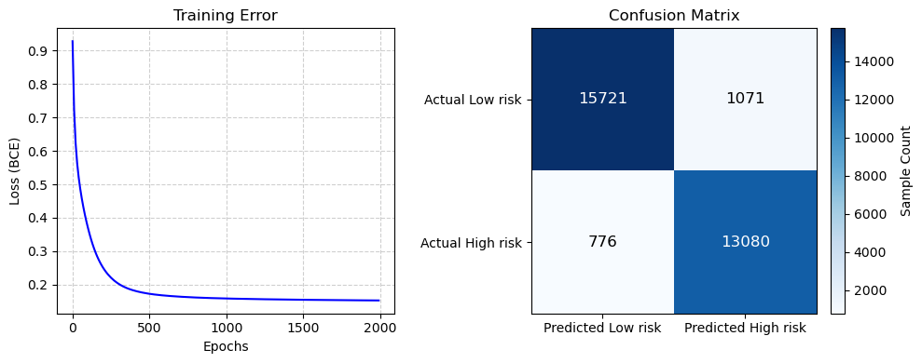
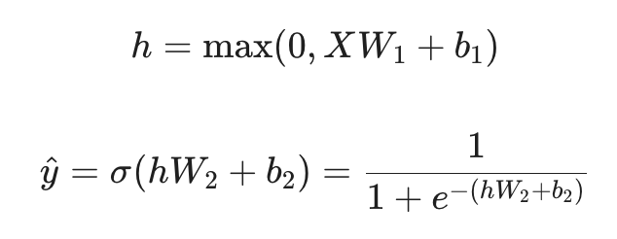
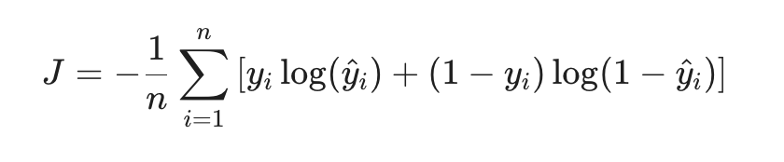
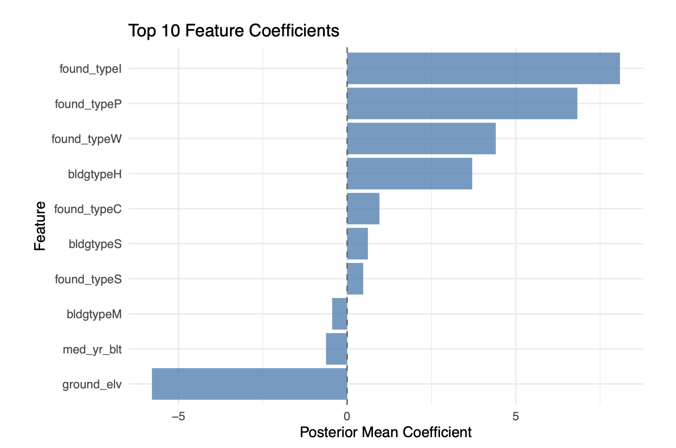
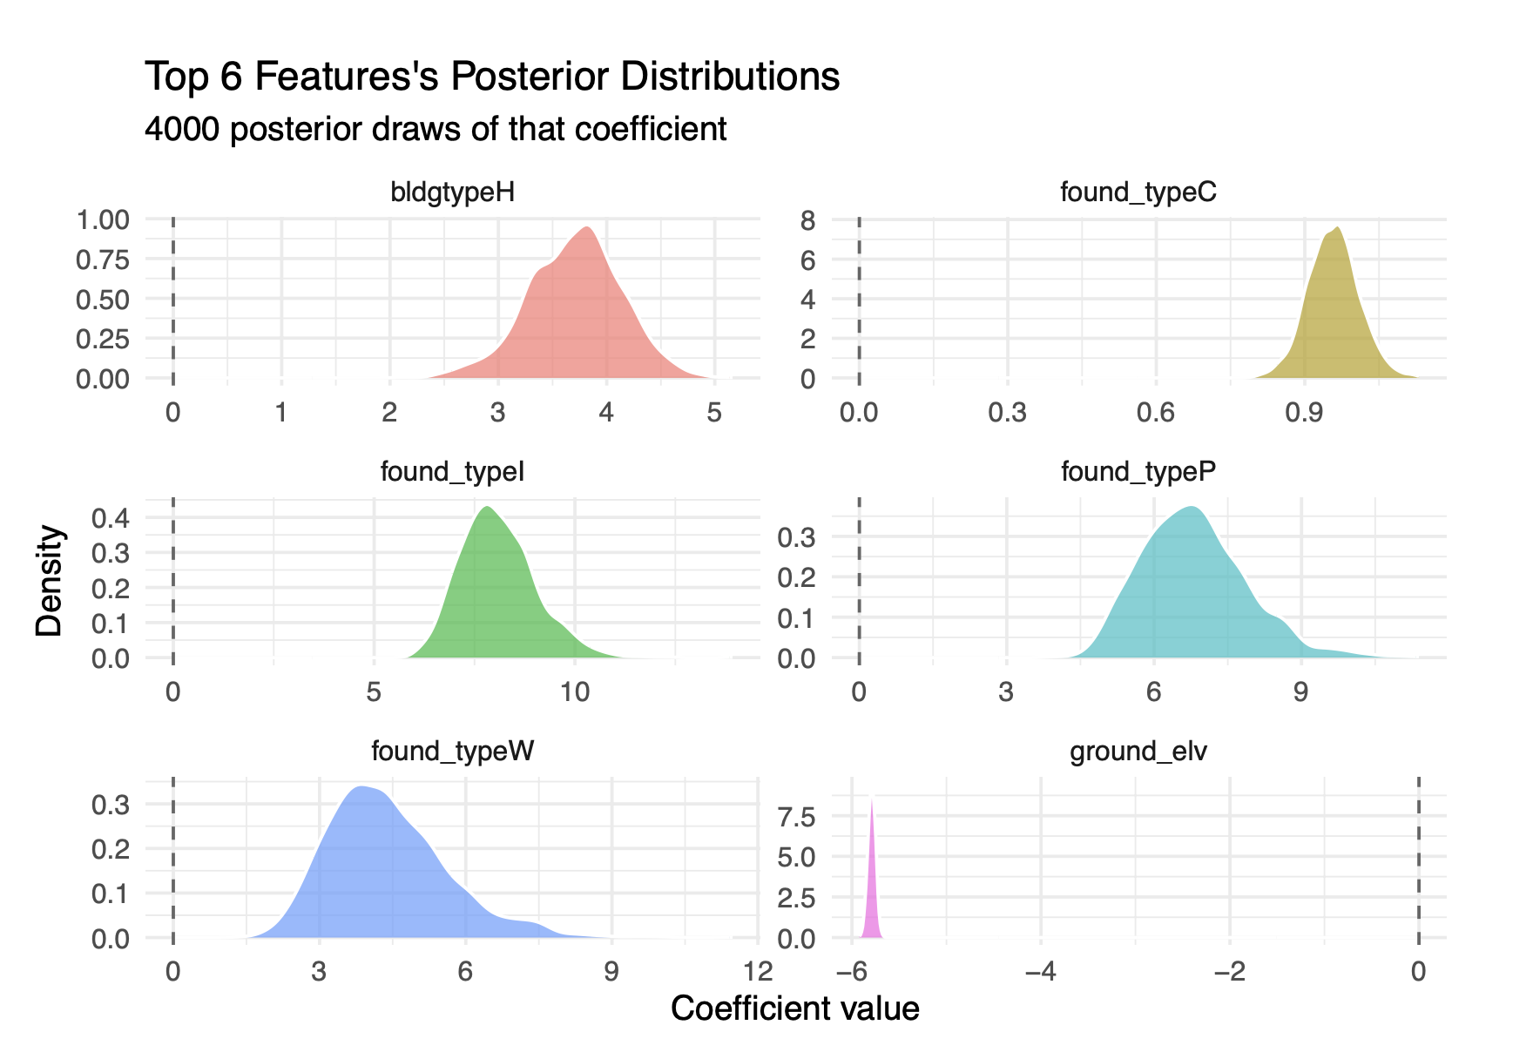


Predicting Building - Level Flood Risk by Analysis Comparison of Multi-Layer Perceptron and Bayesian Logistic Regression
🌊 ☠️
🌊 ☠️
🌊 ☠️
🌊 ☠️
🌊 ☠️
🌊 ☠️
DS4420 Project by: Lang Shao, Jiada Li
Introduction & Problem
Methodology
Figures of MLP Results
The Problem: Current FEMA Flood Insurance Rate Maps (FIRMs) rely on macro-level topographic data, largely ignoring specific physical characteristics of individual structures.
The Consequence: Two houses in the exact same flood zone can have very different actual risk levels depending on micro-level factors (like foundation height).
Our Objective: Leverage National Structure Inventory (NSI) data to model flood risk at the individual building level, moving from zone-level mapping to building-level prediction
1. Custom MLP (By Lang)
Implementation: It was built manually by using Python and NumPy matrix operations Architecture: * Input Layer: d dimensional feature space.
Hidden Layer: 16 nodes with ReLU activation
Output Layer: 1 node with Sigmoid activation for probability mapping
Optimization: Full-batch Gradient Descent minimizing Binary Cross-Entropy (BCE) loss (eta=0.05, 2000 epochs) :
Figures of BLR Results
2. Bayesian Logistic Regression(By Jiada)
Data Overview
Implementation: built using R and rstanarm library
Architecture: * Input: d dimensional feature space.
Prior: Normal distribution with mean=0, std= 2.5 for features. Mean=0, std=10 for intercept
Likelihood: Follow a Bernoulli distribution
Optimization: Use MCMC sampling to retrieve feature weights with iter=1000, chain=4, warmup=500,
Dataset: National Structure Inventory (NSI).
FROM GPKG TO CSV, extract the 153K rows of buildings with FIRM info
Target Variable: FEMA FIRM Zones.
High-Risk (1): VE, AE, A, AO, AH.
Low-Risk (0): Area X.
Key Features: Ground elevation, foundation height, structural value, year built, square footage, number of stories, building type, and foundation type.
Download and documentation: https://www.hec.usace.army.mil/confluence/nsi/technicalreferences/latest/technical-documentation
Conclusions & Future Work
Results & Interpretation
Model Trade-offs: The MLP did better at capturing non-linear patterns, but it's a black-box… unlike the BLR which gives interpretable coefficients. The BLR trades accuracy for interpretability. Its coefficients show foundation type and ground elevation drive flood risk the most.
Future Directions: * Expand the dataset to include diverse geographical regions.
Incorporate a post-hoc interpretability framework, such as SHAP values, to understand the marginal contribution of individual building attributes (e.g., ground elevation) to the MLP's predictions. The BLR model has higher interpretability of the features and uncertainty. The combination of a neural network and a Bayesian model (BNN) could improve the predictability.
1. MLP Results
Predictive Metrics: * Accuracy: 93.97%
Precision: 0.9243
Recall: 0.9440
F1-Score: 0.9341
Key Takeaway: The MLP outperforms the Bayesian Logistic Regression across all metrics, achieving higher accuracy (93.97% vs 92.52%), recall (0.9440 vs 0.7675), and F1-score (0.9341 vs 0.8238). The exceptionally high Recall indicates a very low rate of False Negatives. This ensures vulnerable structures are not mistakenly classified as safe, which is paramount for municipal planning.
2. Bayesian Logistic Regression Results
Predictive Metrics: * Accuracy: 92.52%
Precision: 0.8890
Recall: 0.7675
F1-Score: 0.8238
References
Demissie, Z., et al. (2024). Applied Computing and Geosciences, 23, 100183.
Chen, Y., et al. (2023). Frontiers in Earth Science, 11, 1117004.
Ouma, Y. O., & Lawrence, O. (2023). Int. J. of Intelligent Systems 2023, 5672401.
Qin, X., et al. (2025). npj Urban Sustainability, 5, 19.
U.S. Army Corps of Engineers. National Structure Inventory (NSI) Technical Documentation.

